Slide 1

TEIS Referral
Data Analysis
Nashville Software School
Data Analytics | Cohort 7
Notes:
Introduction

Slide 2
Working Together: Getting Started
For simplicity and clarity, we are going to follow the order of the questions in the readme.
You will need to designate a speaker for the data that was found in your group.
We will need to know how many slides you will need for your portion of the presentation (per group/ question).
If requesting multiple slides, provide the order that you would like the slides to be in.
If you would like specific titles on your slides, please also provide that information. We will otherwise provide a simplified reiteration of the question that the slide will be answering.
EXAMPLE:
QUESTION :What is the rate of re-referral?
SLIDE TITLE : Re-referral Rate
** We will be posting a form to fill out/ gather this information for each group in the DDA7 Slack Channel.

Slide 3
Working Together: Getting Us the Info
Send all project info in the TEIS Project Slack thread within the DDA7 Channel.
When sending info/ charts etc, please make sure to list the question you are working on and slide title/ number if you have multiple.
Please send visuals and text as soon as it is completed in your group. If your question has multiple questions within it that you are answering, please send us each sub-question as you finish it so we can be building out the presentation as you continue to work.
Timeframe: our goal is to have all the visuals and text needed for the slides by the END OF DAY. We understand that may not be possible for all the questions, but please make sure to send us what you have that is completed so that we can continue to format and work through the layout.
EOD: If you are still finishing up visuals/ answering the questions by end of day, please communicate to us what you still have left to do so we can coordinate amf gae our work load for the morning.

Slide 4
Working Together: Colors & Content
Colors: Blue/ Green Font: Default in Python: Open Sans (varieties)
Visuals: Please provide some sort of table or chart for each question (questions can be grouped into a single visual).
Save visuals as a PNG. Trends/ Takeaways: Provide statements of trends in bullet point format. Each team can provide multiple statements of trends as reflected in their data. There is no limit, but so to not be overwhelming to the client, try to limit to 2-3 per group.

Slide 5
Working Together: Next Steps
1.) Fill out the group form posted in the TEIS Slack Thread in the DDA7 Channel ASAP.
QUESTION: (This value should be 1-5 as it corresponds to the ReadMe)
SPEAKER:
NUMBER OF SLIDES:
TITLES/ORDER OF SLIDES:
2.) Send us any visuals or info for your slides as it become available.
3.) Create bullet points of the main takeaways from your findings. These should be in a simplified, statement format that identifies specific trends.

Slide 6
Question 1
Notes:
First question

Slide 7
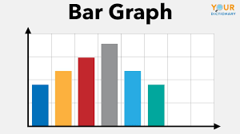
Re-Referral Rate By Year
Info

Slide 8
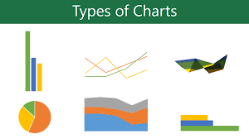
Re-Referral Rate By POE

Slide 9
Re-Referral Rate By POE

Slide 10
Question 2
Notes:
Second Question

Slide 14
Average Age and Rate of Successful Referrals by POE
Notes:
Third Question

Slide 15
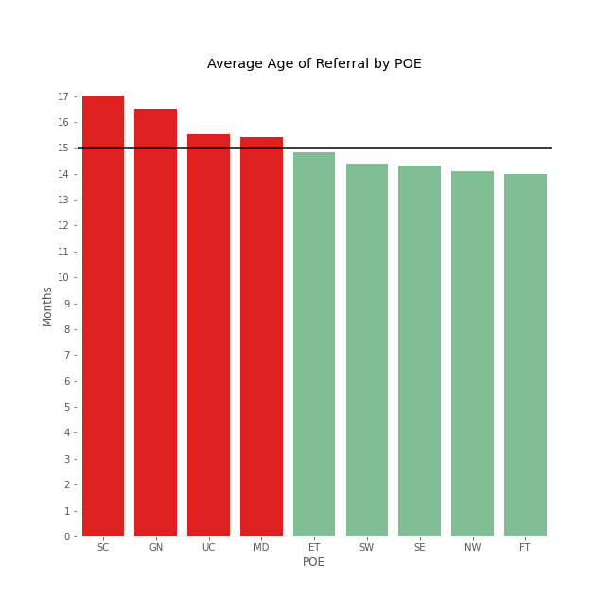
What is a child’s average age at referral? How do POE’s compare?
*Potential POEs of concern where average age of referral is greater than 15 months are
South Central (17.01 months)
Greater Nashville (16.49 months)
Upper Cumberland (15.54 months)
Memphis Delta (15.40 months)
15 months
*Notification date used for calculation
Notes:
Calculated using the notification date to understand the average age of a child when referred
Calculated the number of days from DOB to notification date and converted to age in months
The black line represents the target of 15 months (maximum age of concern)
4 potential POEs of concern (listed on slide)

Slide 16
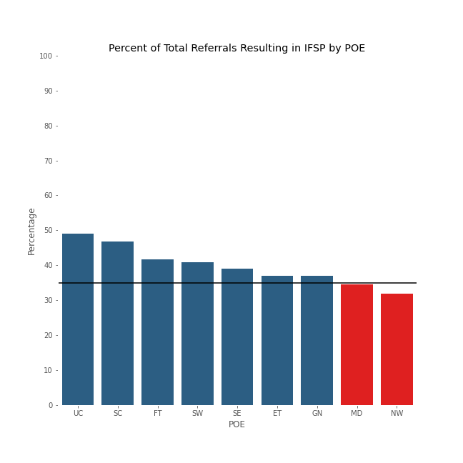
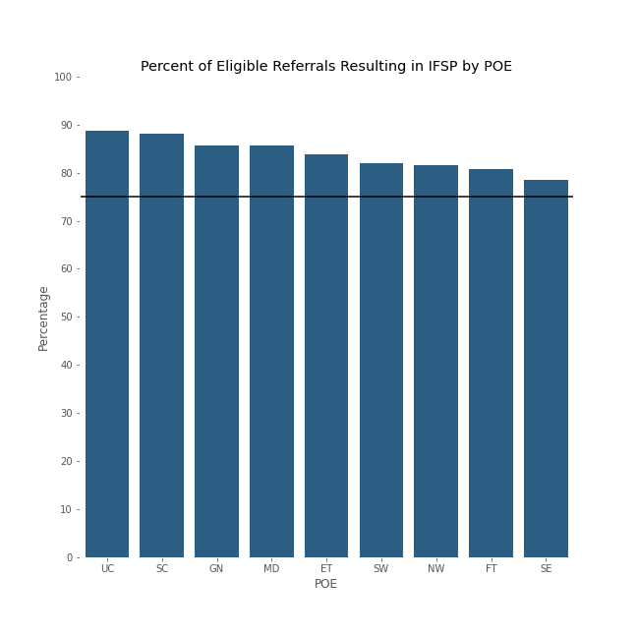
Total Referral vs Eligible Referral IFSP Result How do POE’s compare?
75%
35%
*Only POE’s of potential concern are
Memphis Delta (34.45%) and Northwest (31.87%)
Notes:
Fig 1 (on the left)
Represents the percentage of total referrals that resulted in an IFSP broken down by POE
The black line represents the target percentage of 35%
2 POEs of potential concern (listed on the slide) fell below 35%
Fig 2 (on the right)
Represents the percentage of all eligible referrals that resulted in an IFSP broken down by POE
The black line represents the target percentage of 75%
NO POE’s of concern for this metric
Takeaway –
Memphis Delta has a higher age of referral and a lower percent of total referrals resulting in an IFSP
Eligible children have a higher percentage of resulting in an IFSP.
Parental consent/understanding is a critical component in reaching eligibility (extra data of this is available upon request please refer to Michael Norman)
Did not attempt to establish a correlation between the average age of referral and successful referrals, further research is recommended

Slide 17
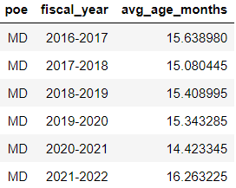
Average Age of Referral for Memphis Delta by Year

Slide 18
Key Points
Memphis Delta is a potential POE of concern with a higher average age of referral and a lower percent of total referrals resulting in an IFSP
Eligible children have a higher percentage of resulting in an IFSP.
Parental consent/understanding is a critical component in reaching eligibility (extra data of this is available upon request please refer to Michael Norman)
Did not attempt to establish a correlation between the average age of referral and successful referrals, further research is recommended

Slide 19
Question 4
Notes:
Fourth question

Slide 22
Question 5
Notes:
Last question

Slide 26
Key Takeaways
Please bullet point out 1-3 of the key trends you saw in your specific question.
These will serve as a good reference point for TEIS in reviewing the key trends identified for each question.
Notes:
Summary/ Recommendations

